Slide 1
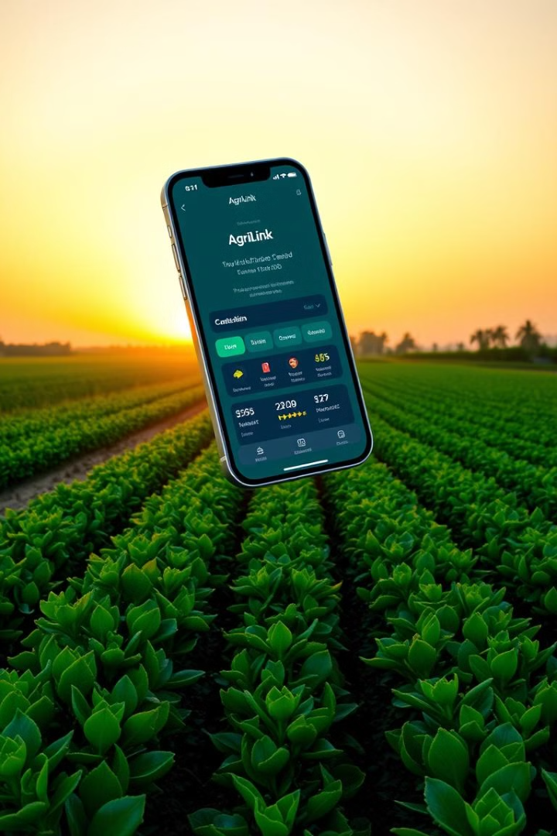
AgriLink: Connecting Farmers & Consumers Directly
Hackathon Project Presentation by codefusion

Slide 2
Introducing AgriLink: Connecting Farmers to the Future
Revolutionizing Agriculture
Bridging the Gap
Market Disruption
All-in-One Solution
Technology-driven solutions.
Connecting farmers to markets.
$500B+ agricultural market.
Your complete farming solution.

Slide 3
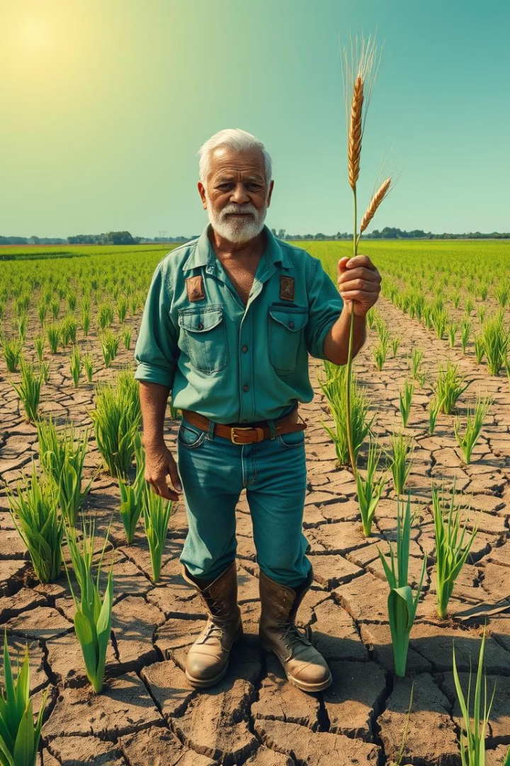
Farmers Face Critical Challenges
1
Limited Market Info
Only 20% access real-time data.
2
Inefficient Supply Chains
30-40% post-harvest losses.
3
Lack of Financial Access
60% unbanked or underbanked.
4
Difficulty Adopting Techniques
Only 25% use precision agriculture.

Slide 4
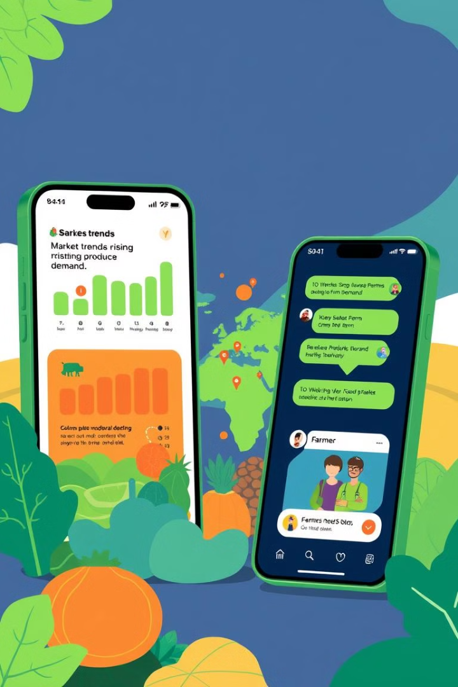




AgriLink: The Solution
Real-Time Market Prices
Data from 500+ markets.
Direct Buyer Connections
Increase profits by 15-20%.
Seamless order management
Tailored loan and insurance.
Moblie and web based platform
Optimizes field

Slide 5





Key Features of the AgriLink App
Farmer proflie and product listing
Marketplace
Direct messaging and negotiation
order placement and confirmation
Buy and sell produce directly.

Slide 6
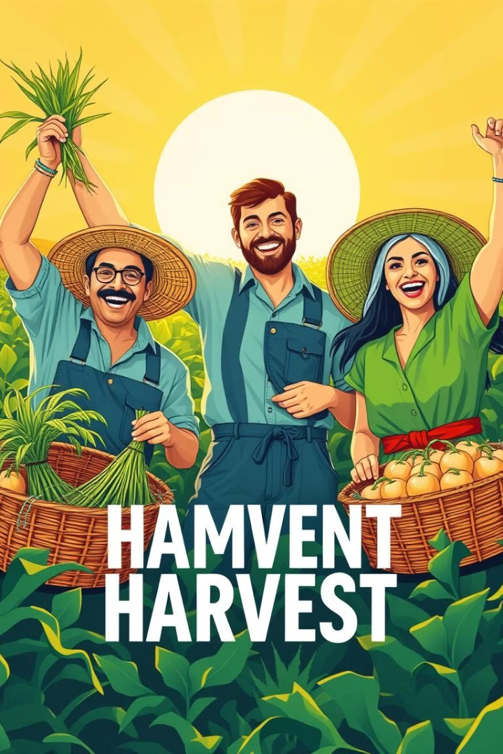
Benefits for Farmers
25%
Increased Income
Direct sales & better pricing.
15%
Reduced Losses
Efficient supply chain.
40%
Access to Resources
Credit and insurance access.

Slide 7




Expected Impact
Fresh & Affordable Produce
Higher Earnings
1
Fair value for produce.
2
Direct farm-to-table.
Increased Market Reach
4
Seamless Transactions
3
Connect with buyers.
AI price matching.
Transforming agricultural trade through technology

Slide 8
Future Plans and Vision
Expansion
1
South Asia, Africa in 2 years.
2
AI Integration
Crop disease detection.
Blockchain
3
Traceability for food safety.
4
Different agriculture market globally
Advanced marketing scope
Reach
5
1 million farmers by 2026.

